Slide 1

Relationship of Temperature on Crime Rates Across North America
Amit Malik, Blake Schwartzbach and Nick Adams

Slide 2
Motivation & summary
To determine if there was a significant difference in the hourly temperature between New York and Philadelphia
We wanted to see if there was a statistically significant difference between the weather in two cities close to each other
Determined that there was a significant difference in hourly temperatures between the two cities
To determine if there was a relationship between crime rates and temperature in various cities
Does Crime rate increase as temperature increases?
Determined that Crime rate increases as temperatures Increase across most North American cities

Slide 3

Data
Temperature
Measured hourly temperature data for various cities from Weather API and OpenWeatherMap from Kaggle [REF1]
Crime Rates
Needed data of crime rates across multiple cities to be able to compare to the temperature, falling in the same year for the temperature data [ref2-6]
Data collected from various Kaggle sources in different formats had to be cleaned up
Chicago, Philadelphia, Los Angeles, Vancouver, NYC

Slide 4
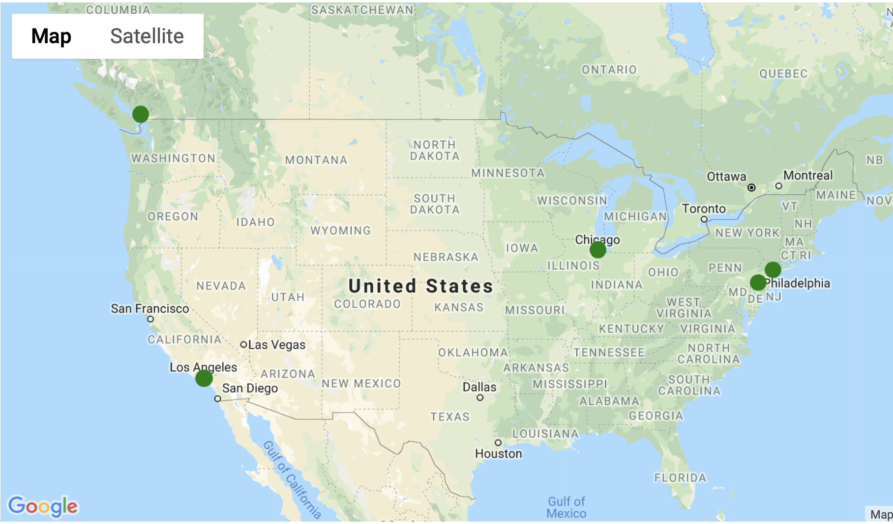
Cities Selected
Chicago
Philadelphia
Los Angeles
Vancouver
New York
Vancouver
Chicago
New York
Philadelphia
Los Angeles

Slide 5
Data Challenges
REFERENCE SLIDE
Data was collected from 6 different sources mentioned in the references with various different formats
Large Sizes of crime databases easily parsed using Python, Pandas and tools and techniques learnt

Slide 6
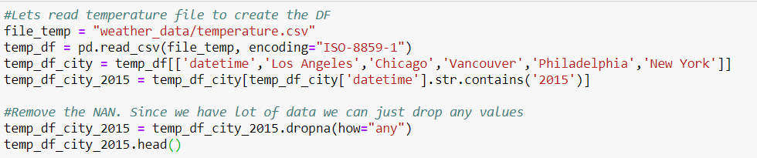
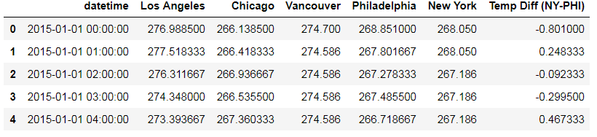
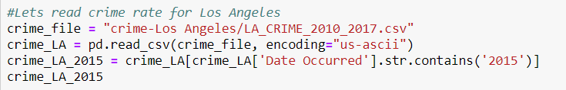
Data Cleanup & Exploration
REFERENCE SLIDE
Pulled out individual cities from a csv file containing hourly weather data for multiple major cities across North America, removing NAN values to ensure a clean data set
Created a column comparing difference in temperatures between New York and Philadelphia on an hourly level
Read in the CSV files containing crime data for various cities, making sure to only pull out data for 2015 as the set contained multiple years worth of data within it

Slide 7
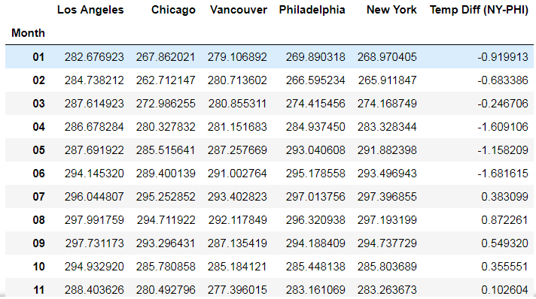
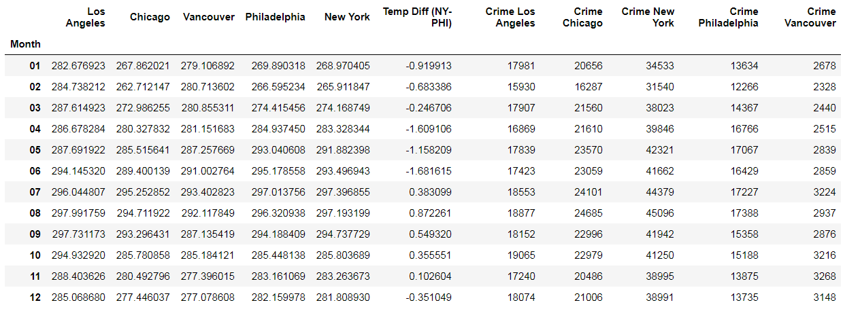
Data Cleanup & Exploration
REFERENCE SLIDE
Split out the date the reported crime occurred on using various delimiters depending on the formatting of the date in the source file based on city
Grouped all data sets by month to ensure we had comparable data across the same time period in the same format
Pulled in all the crime rates by city by month as well as temperature by city by month into a single data frame for comparative analysis

Slide 8
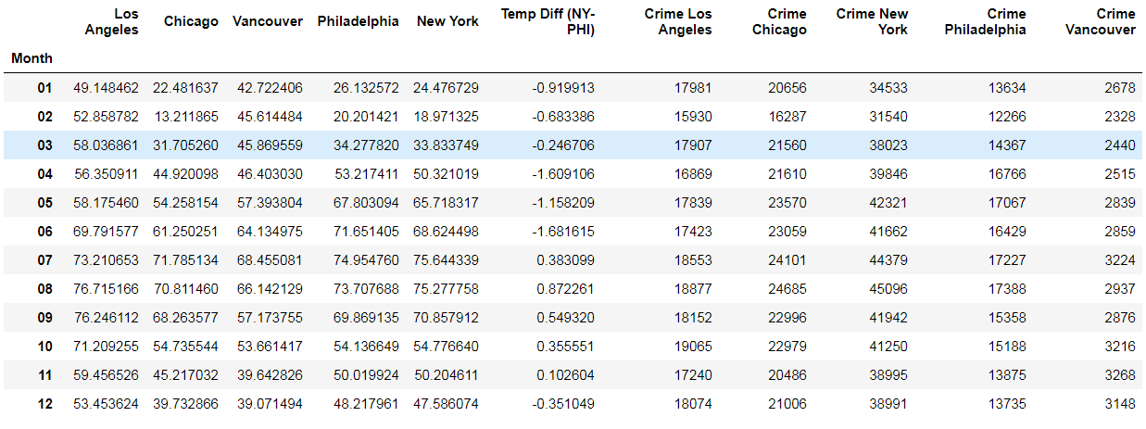
Data Analysis
REFERENCE SLIDE
Cleaned up data file exported to CSV shown below:

Slide 9
Data Analysis
determine if there was a significant difference in the hourly temperature between New York and Philadelphia

Slide 10
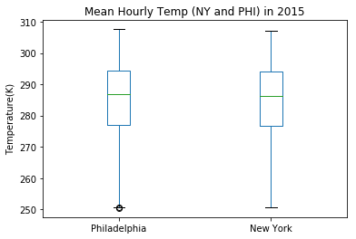
Data Analysis
Question: Is there a significant difference in the hourly temperature between NY and PHI?
Ran a years worth of hourly temperature data through a box plot where, at first glance, it appears that both cities’ data is extremely similar

Slide 11
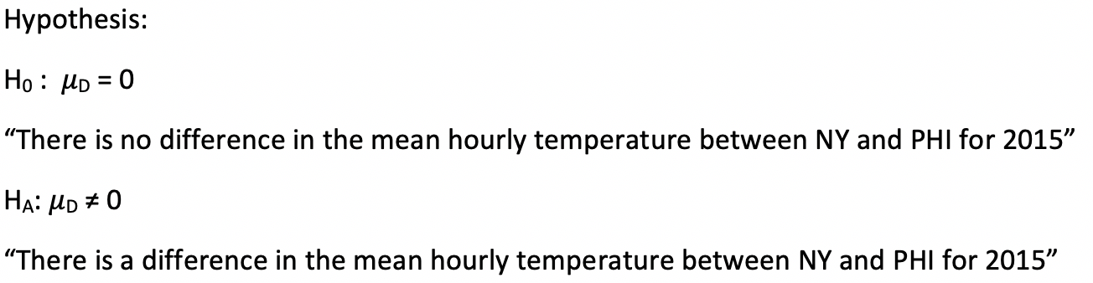
Data Analysis
Question: Is there a significant difference in the hourly temperature between NY and PHI?
Hypothesis Test: Paired t-test

Slide 12
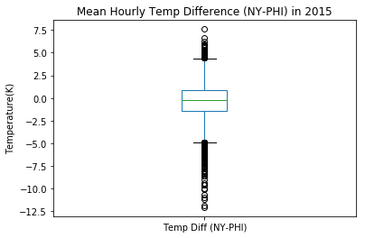
Data Analysis
Question: Is there a significant difference in the hourly temperature between NY and PHI?
We then used the column containing the difference in temperature between the two cities for every hour of 2015 to create boxplot to show the distribution of data points
Multiple outliers in the dataset which we wanted to remove in order to increase the strength of our hypothesis test

Slide 13
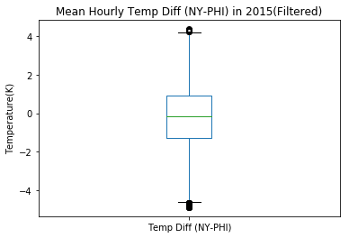
Data Analysis
Question: Is there a significant difference in the hourly temperature between NY and PHI?
Using code we removed 236 outliers from the data set of 8760, allowing us increase the strength of our hypothesis test

Slide 14
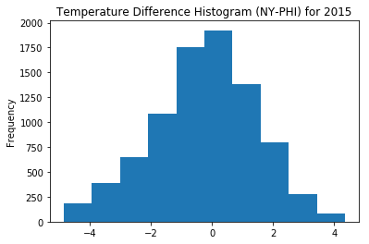
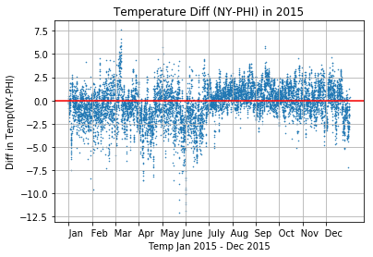
Data Analysis

Slide 15
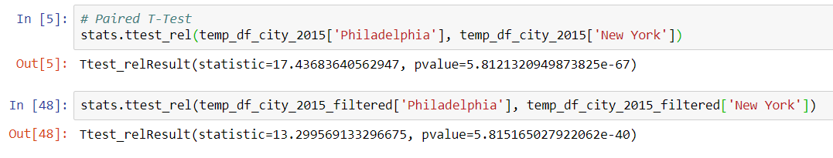
Data Analysis
Question: Is there a significant difference in the hourly temperature between NY and PHI?
Using both the data set with outliers in it as well as the filtered data set, we ran T-Tests to finally determine if there was a significant difference in the temperatures between two cities across an entire year
Dataset with Outliers: | Dataset with Outliers Removed:
T = 17.44 T* = 1.96 | T = 13.3 T* = 1.96
P = 5.8121e-67 | P =5.8151e-40

Slide 16
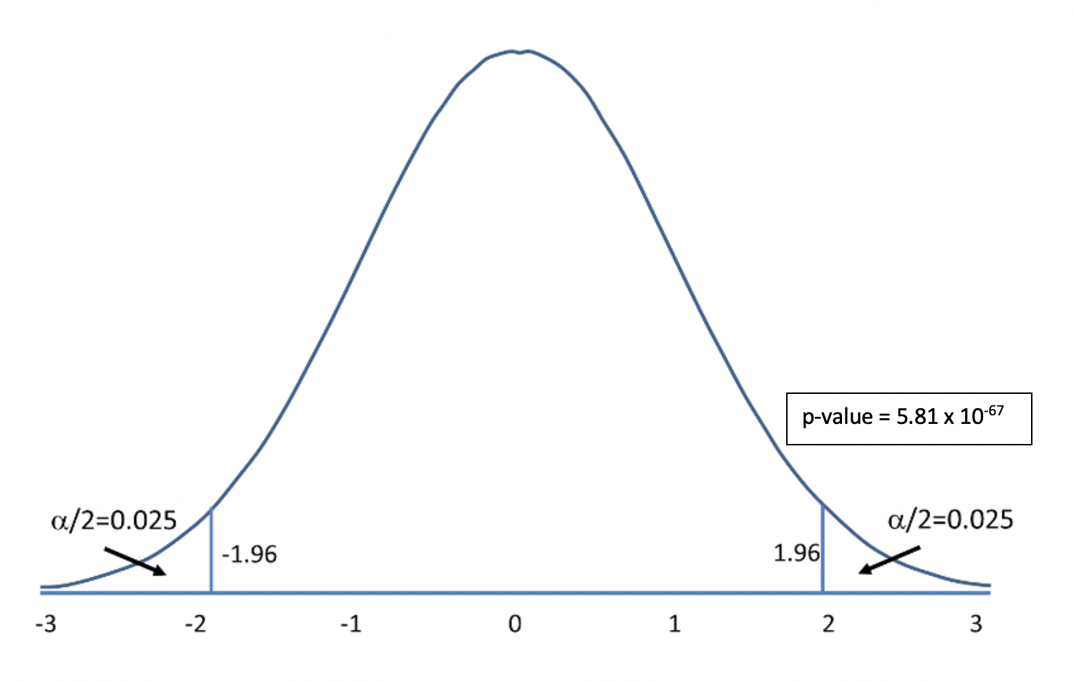
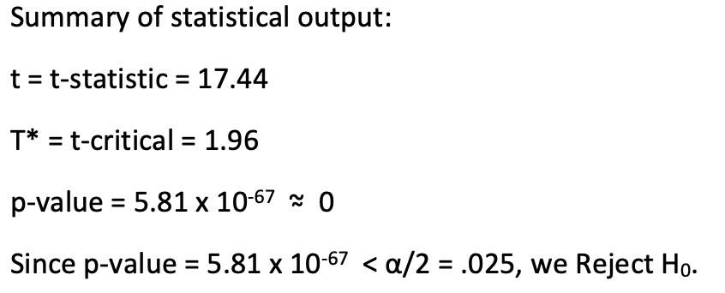
Data Analysis
Question: Is there a significant difference in the hourly temperature between NY and PHI?
There is a significant difference in the mean hourly temperature between NY and PHI for 2015.

Slide 17
Data Analysis
determine if there was an impact on crime rates across various cities based on varying temperatures

Slide 18
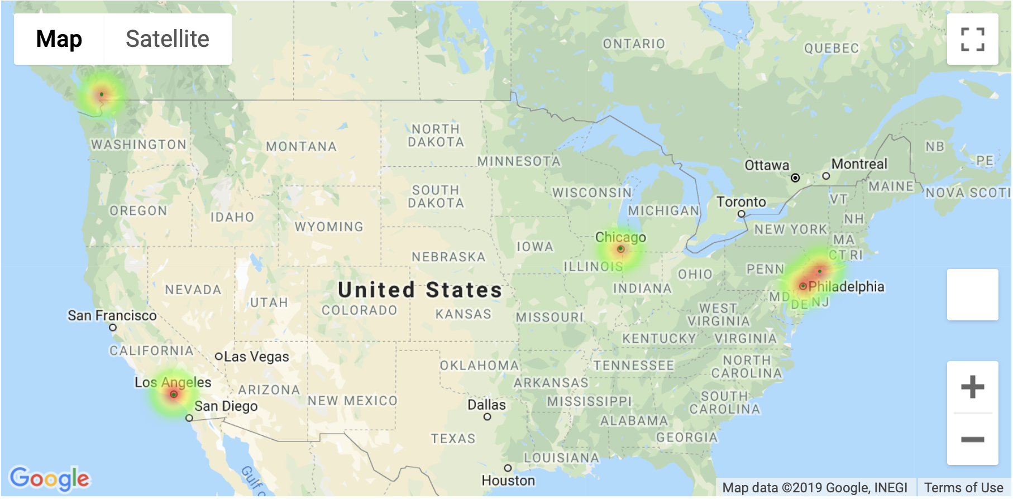
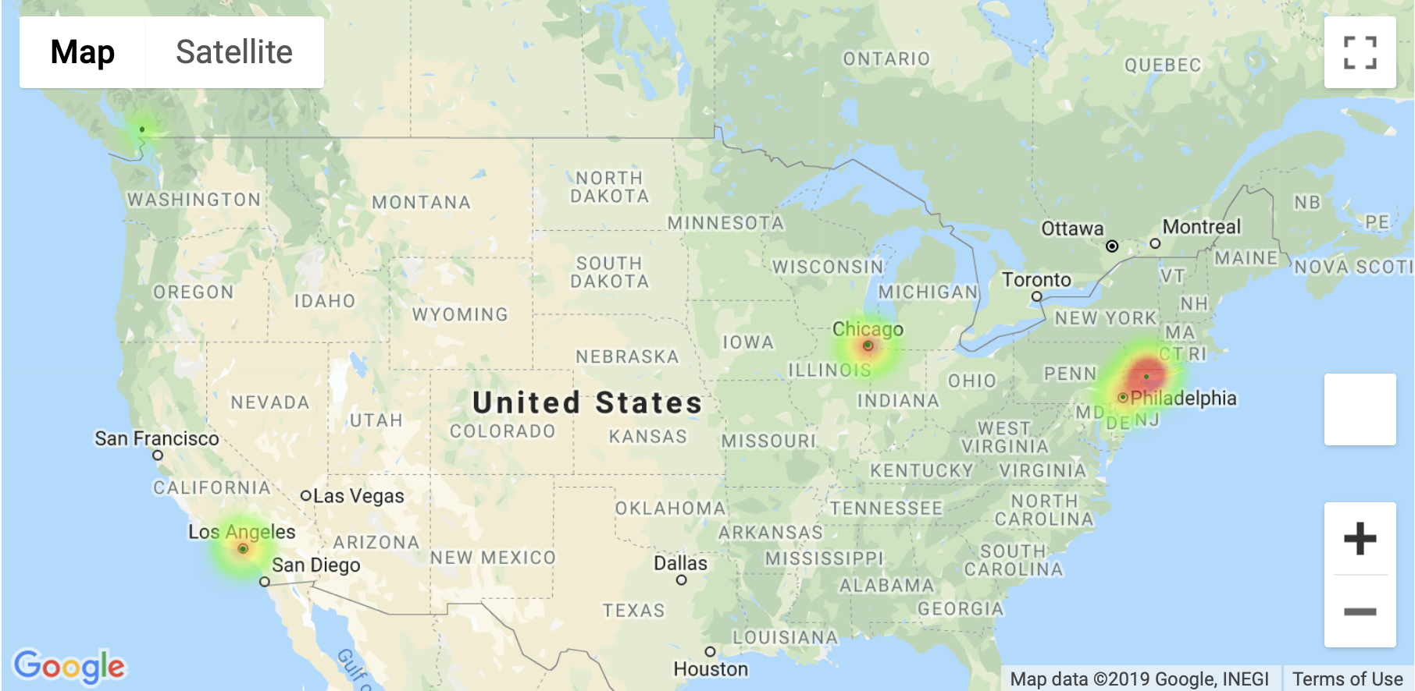
Avg Daily temperature vs total crime rate
Average Temperature
Total Crimes

Slide 19
Data Analysis
REFERENCE SLIDE
determine if there was an impact on crime rates across various cities based on varying temperatures
Cleaned up data file exported to CSV shown below:

Slide 20

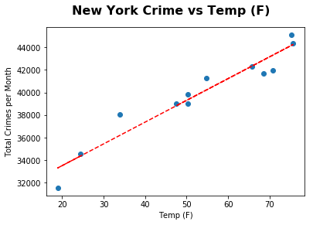
Data Analysis
determine if there was an impact on crime rates across various cities based on varying temperatures
Equation of best-fit line:
Crimes/mon = 29643 + 193 x Temp
R-value = 0.962
R-sq = 0.926
92.6% of the variation of Total Crimes per month can be explained by Temp

Slide 21
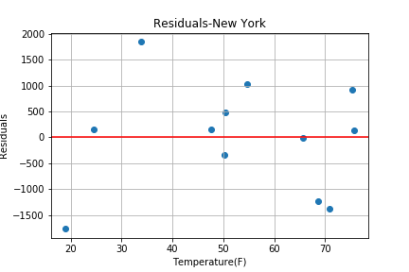
Data Analysis
determine if there was an impact on crime rates across various cities based on varying temperatures
Equation of best-fit line:
Crimes/mon = 29643 + 193 x Temp
R-value = 0.962
R-sq = 0.926
92.6% of the variation of Total Crimes per month can be explained by Temp

Slide 22

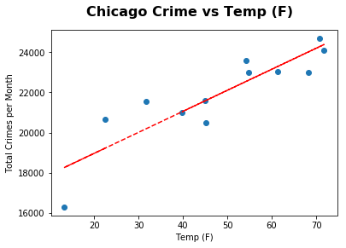
Data Analysis
determine if there was an impact on crime rates across various cities based on varying temperatures
Equation of best-fit line:
Crimes/mon = 16865 + 104 x Temp
R-value = 0.889
R-sq = 0.79
79.0% of the variation of Total Crimes per month can be explained by Temp

Slide 23

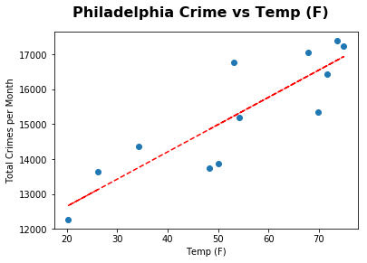
Data Analysis
determine if there was an impact on crime rates across various cities based on varying temperatures
Equation of best-fit line:
Crimes/mon = 11081 + 78 x Temp
R-value = 0.867
R-sq = 0.752
75.2% of the variation of Total Crimes per month can be explained by Temp

Slide 24

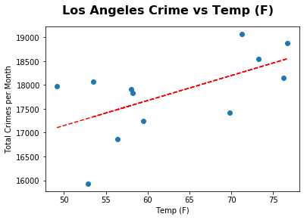
Data Analysis
determine if there was an impact on crime rates across various cities based on varying temperatures
Equation of best-fit line:
Crimes/mon = 14523 + 52 x Temp
R-value = 0.594
R-sq = 0.353
35.3% of the variation of Total Crimes per month can be explained by Temp

Slide 25

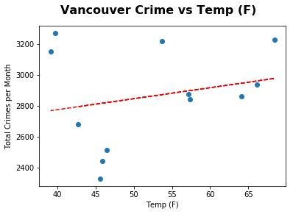
Data Analysis
determine if there was an impact on crime rates across various cities based on varying temperatures
Equation of best-fit line:
Crimes/mon = 2490 + 7 x Temp
R-value = 0.231
R-sq = 0.053
5.3% of the variation of Total Crimes per month can be explained by Temp

Slide 26
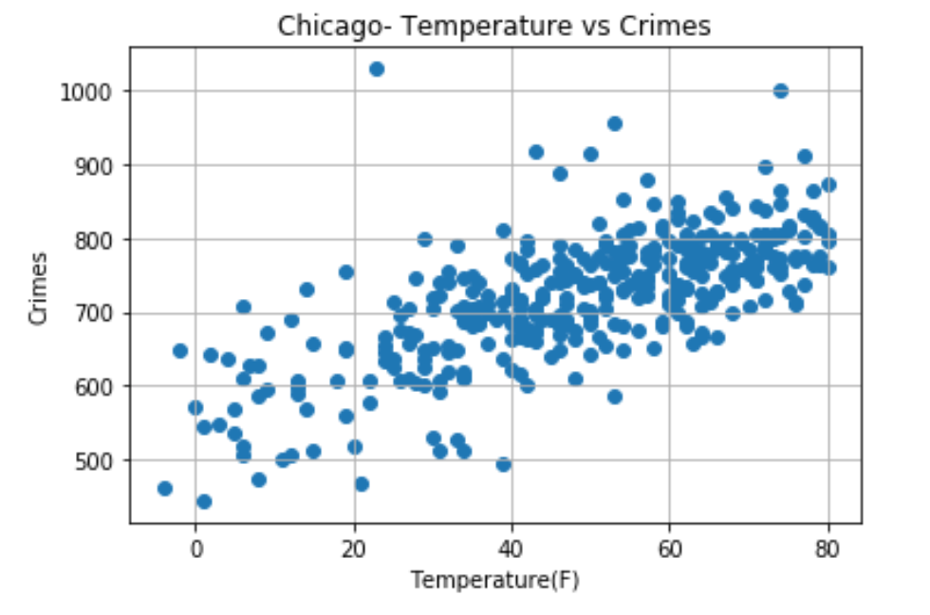
Data Analysis
Detailed dive into individual market: CHICAGO
Chicago crime data is analyzed on a daily basis. Clearly as the average temperature increases per day the crime rate seems to go up!
Similar analysis is being repeated for all the other 4 markets

Slide 27
Conclusions
There is a significant difference between temperature of two cities as we expected
There seems to be a relationship between the temperature and crime rate for most cities
As temperature increases, the crime rate increases
Our model predicts that in New York City, there will be no crime at -153.5F

Slide 28
Post Mortem
difficulties :
Lack of datasets
API access limited
Complete Pivot to original problem statement
Different sources of crime data
What’s next:
Detailed dive into remaining 4 individual markets
Find relationship between different crime types and temperature
Murders, GTA, Robbery, etc

